Slide 1
MUST Graduate Application Forum
- Progress Report 1
Group members: He Xinyi ,Cao Yulong, Chen Rui, Lu Jie

Slide 2
Contents
01 | User Stories of 3 Sprints
02 | Sprint 1 Progress - MVP
03 | Source code
04 | Project Management Process
05 | Challenges Encountered in JIRA+Scrum

Slide 3
01 | User Stories of 3 Sprints
Review: MUST Graduate Application Forum
User Stories Overview
Prioritize by 3 Sprints

Slide 4
MUST Graduate Application Forum
MUST Graduate Application Forum is a website
The target group is MUST students
Provide MUST students with cases of successful applications of previous MUST students
Build the communication between students who want to apply and students who have applied successfully

Slide 5
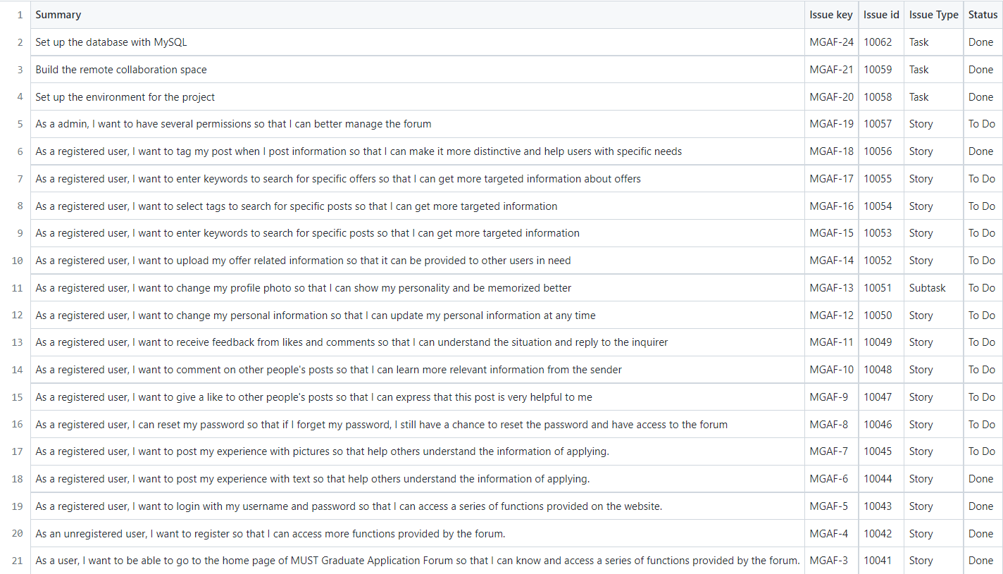
User Stories Overview

Slide 6
User Stories Overview
Main Page - 3
Registration - 5
Login - 2
Password Reset - 3
Post Text - 3
Post Picture - 5
Give Likes to Others’ Posts - 3
Comment on Others’ Post - 5
Receive Feedbacks - 3
Change Personal Information - 3
Set or Change Profile Photo - 2
Offer Information Sharing - 5
Search by Keywords - 5
Search by Tags - 3
Search Offers - 5
Tag the Post - 3
Admin Management - 5
Total number of user stories: 17
Total number of user story points: 62

Slide 7
Prioritize by 3 Sprints
Sprint 1
Main Page
Registration
Sprint 2
Post Pictures
Give a Like
Sprint 3
Receive Feedbacks
Offer Searching
Login Page
Post Text
Reset Password
Make Comments
Upload Offer Information
Admin Management
Change Personal Information
Searching by Keywords
Searching by Tags
(Environment Setting & Database Setting)

Slide 8
02 | Sprint 1 Progress - MVP
Workflow
Active Sprints
Release – Version 1.0
Sprint 1 User Stories

Slide 9
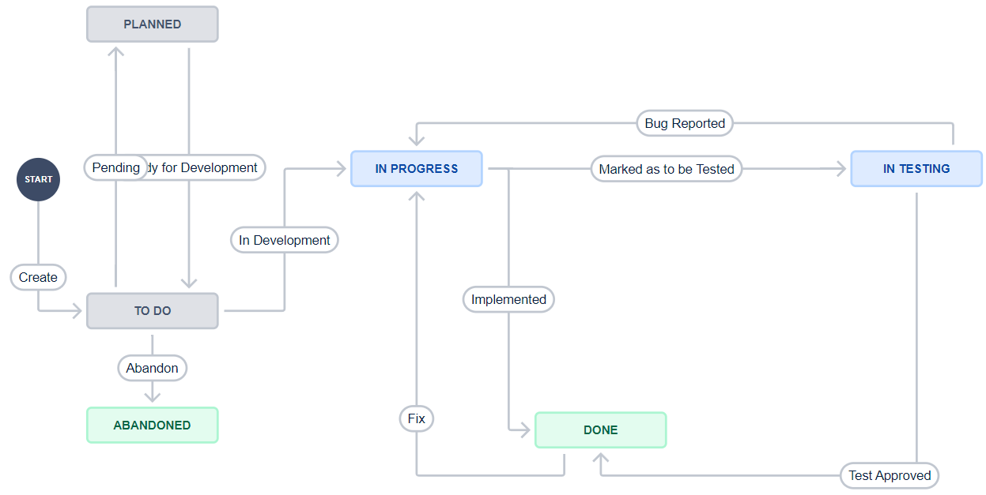
Workflow

Slide 10
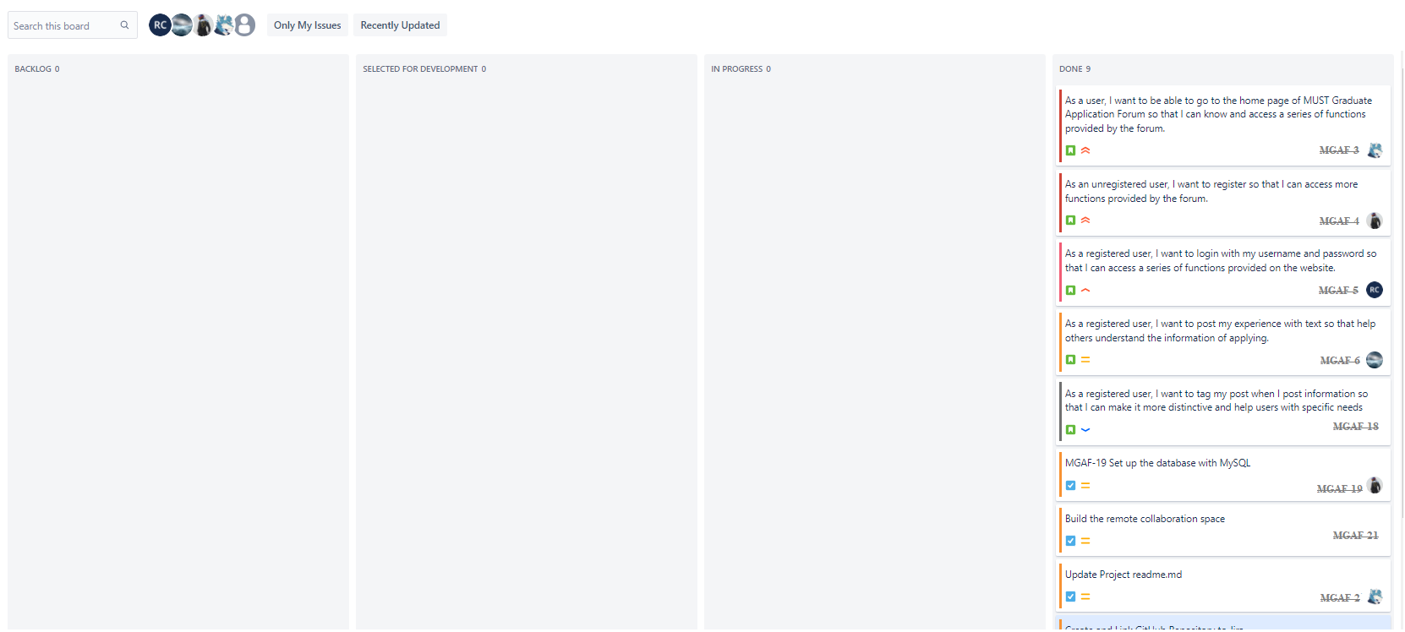
Active Sprints

Slide 11
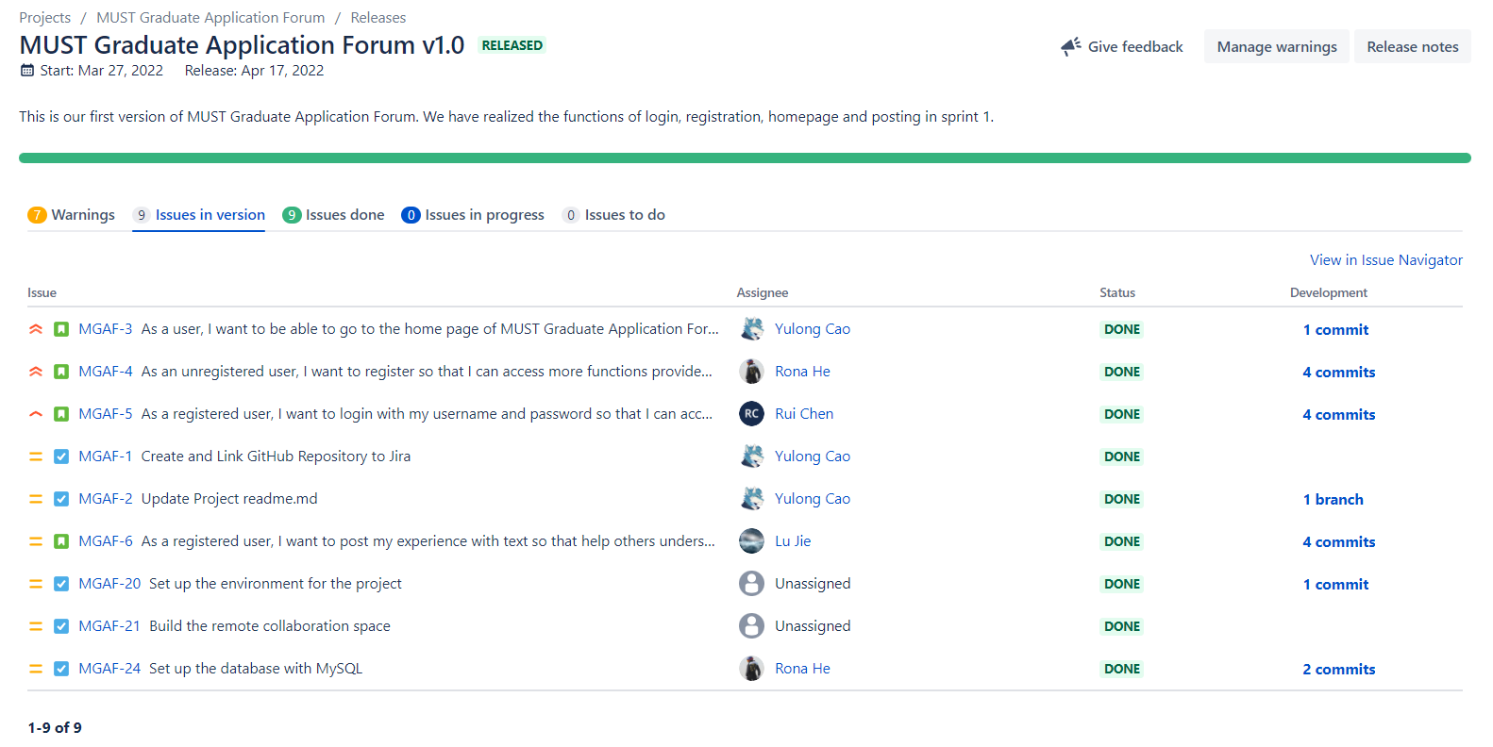
Release – Version 1.0

Slide 12
Sprint 1 - User Stories We Have Done
1. Main Page
As a [user], I want to [be able to go to the home page of MUST Graduate Application Forum] so that [I can know and access a series of functions provided by the forum.]
2. Registration
As an [unregistered user], I want to [register] so that [I can access more functions provided by the forum.]
3. Login
As a [registered user], I want to [login with my username and password] so that [I can access a series of functions provided on the website.]
4. Post Text
As a [registered user], I want to [post my experience with text] so that [help others understand the information of applying]

Slide 13
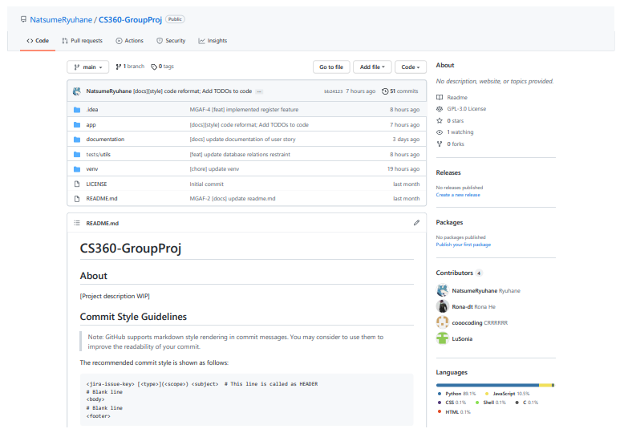
GitHub

Slide 14
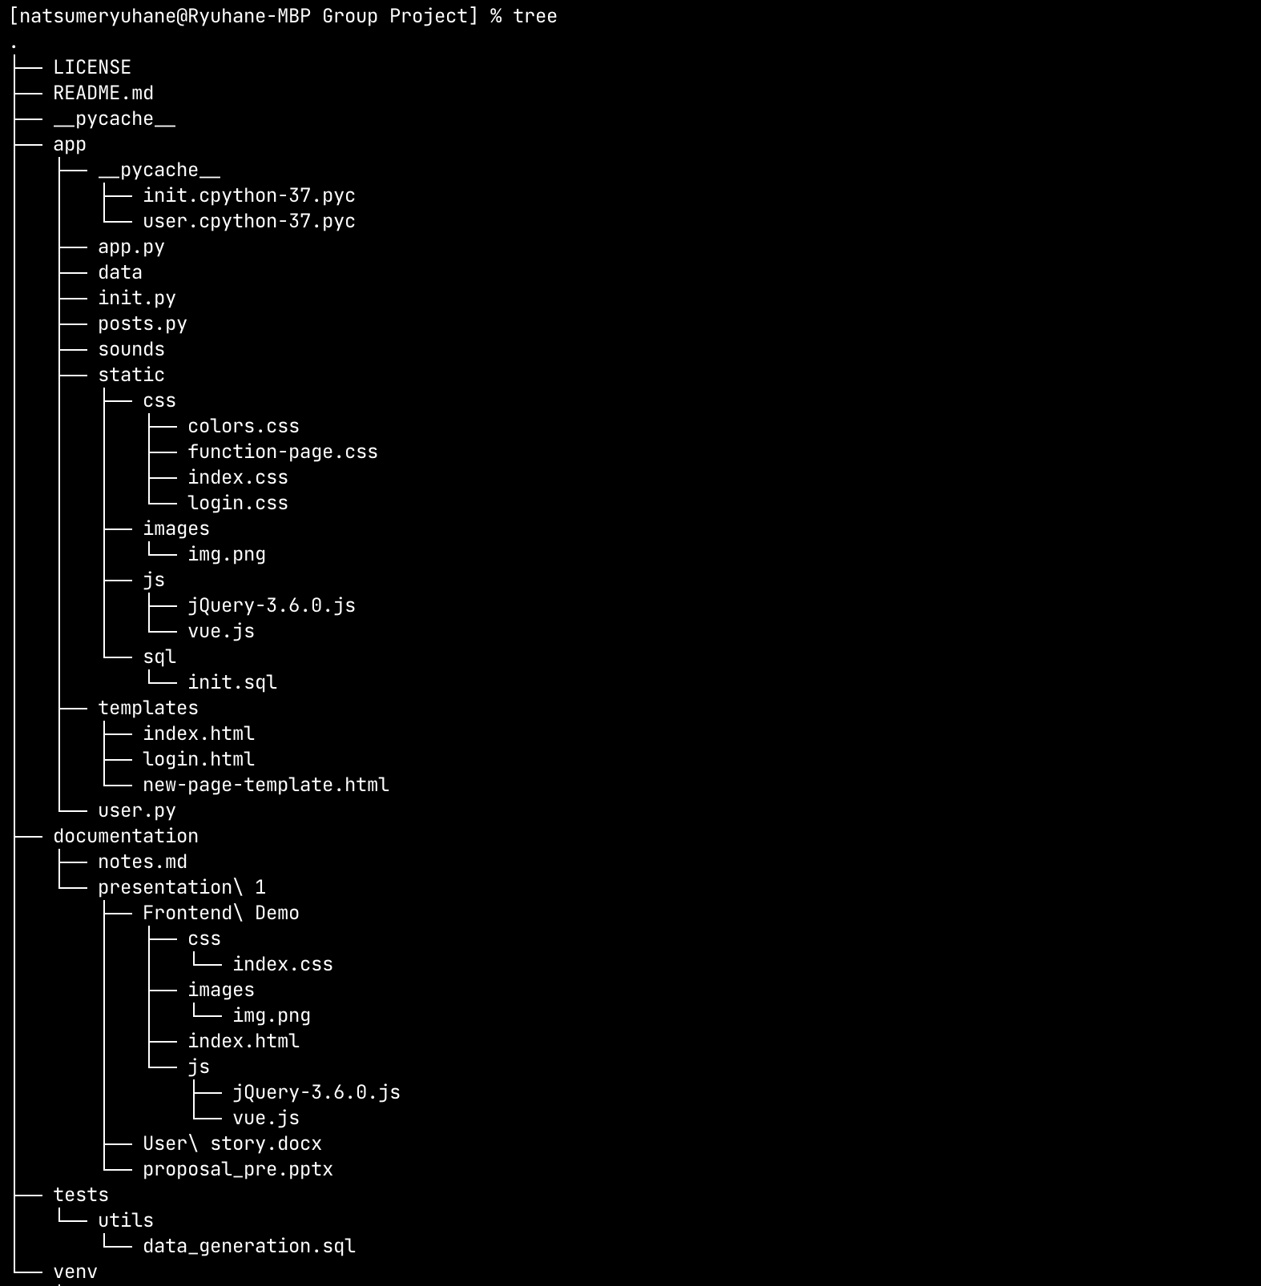
File Structure

Slide 15
03 | Source Code

Slide 16
04 | Project Management Process
Burndown chart
Burnup chart
Sprint report
Velocity report

Slide 17
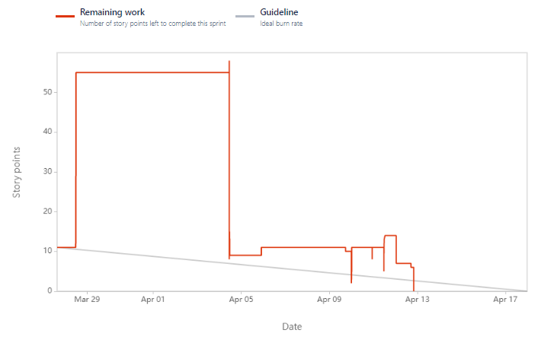
Burndown Chart
Red line: Number of story points left to complete in sprint 1.
Completed on April 13.
Fluctuations
Burndown Chart

Slide 18
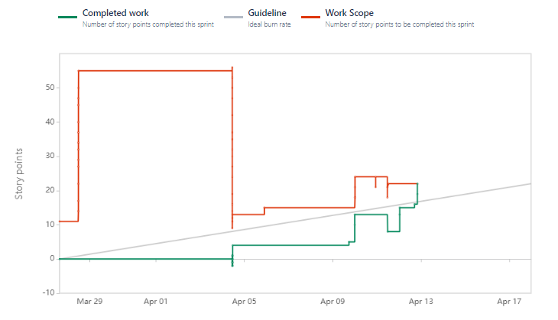
Burnup Chart
Red line: Number of story points to be completed in sprint 1.
Green line: Story points completed in sprint 1.
Confluence point: Completed 22 story points on April 13.
Burnup Chart

Slide 19
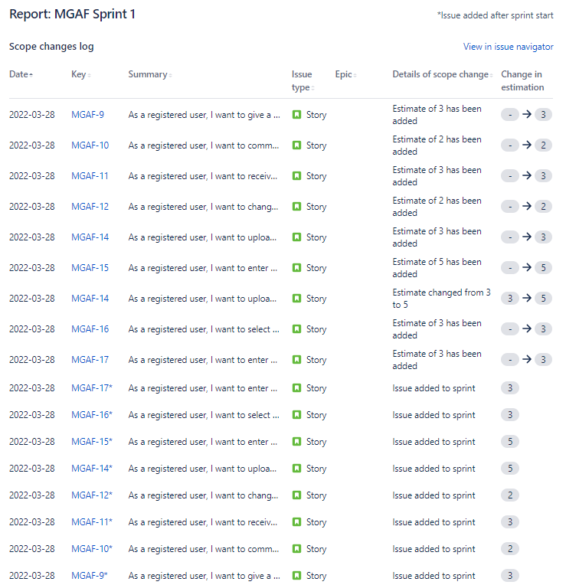
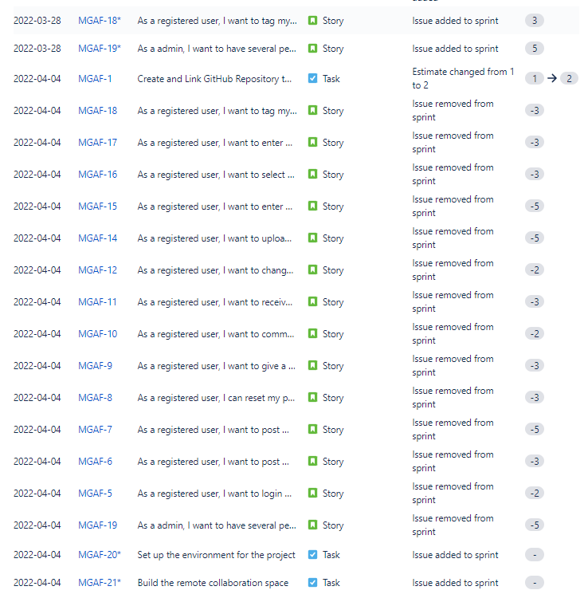
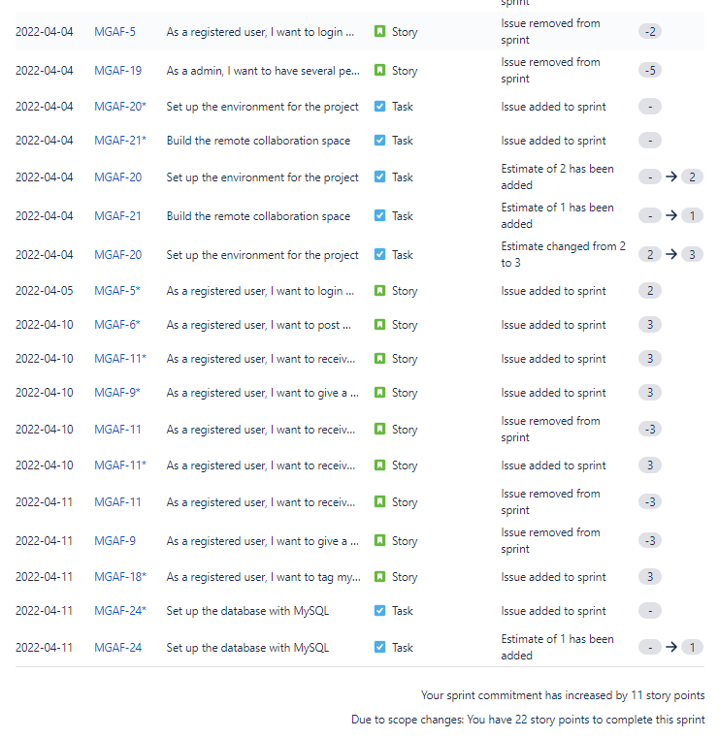
Sprint Report
Issue information:
Issue date, key, type, summary, scope changes
Completed issues, incomplete issues

Slide 20
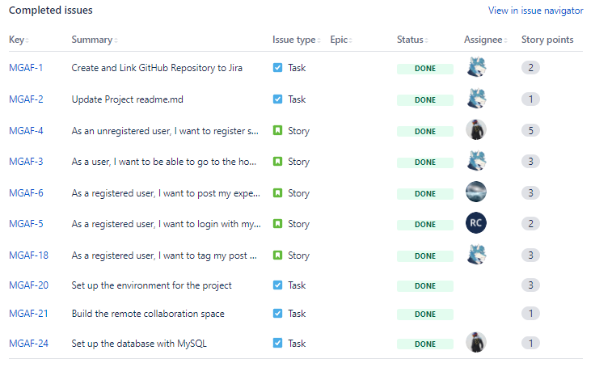
Sprint Report
Completed 22 story points in sprint 1
Sprint commitment has increased by 11 story points
Sprint Report

Slide 21
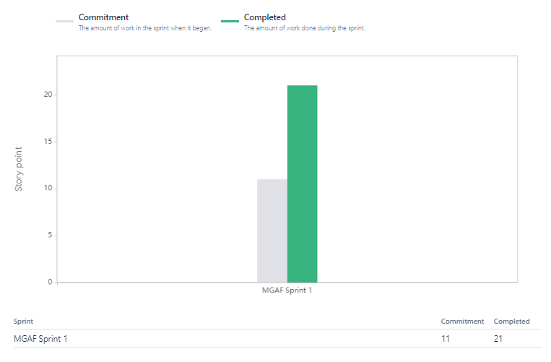
Velocity Report
Green column: The number of work done in sprint 1.
Total commitment: 11
Total completed: 21
Velocity Report

Slide 22
05 | Challenges Encountered in JIRA+Scrum

Slide 23
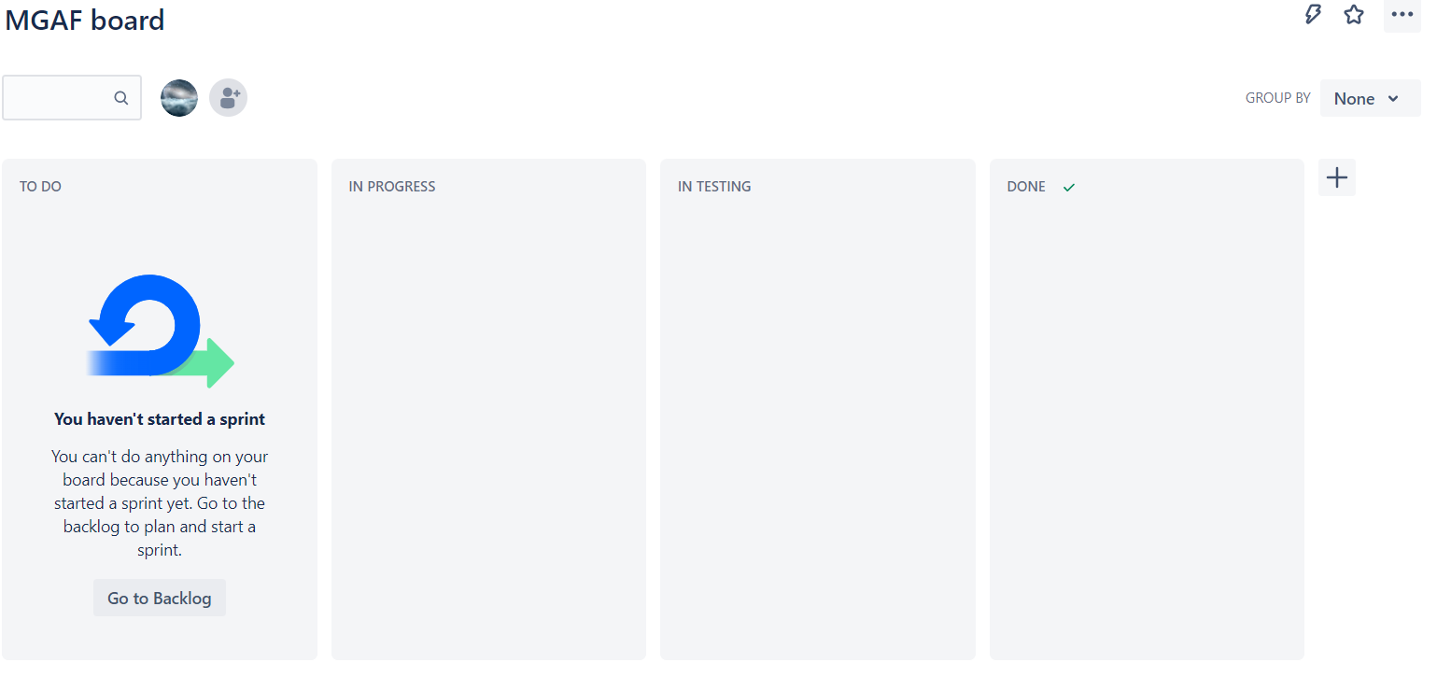
1. We cannot view the workflow of issues of the complete sprint in the board.
The way to solve: establish a good project management, count the project information.

Slide 24
2. JIRA adopts an unconventional model which allows multi-repository development to a particular project
The way to solve: read the official documents.
3. We encountered some problems in installations of the GitHub plug-in because of not understanding the permission control in JIRA.
The way to solve: read the official documents, set a test project to experiment.

Slide 25
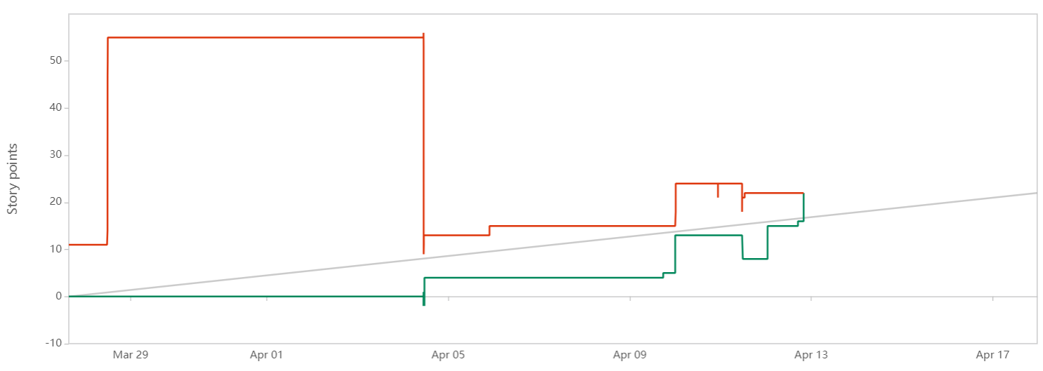
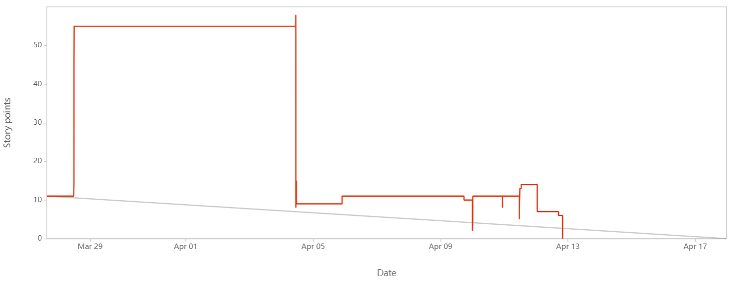
4. Incorrect allocation of sprints at the very beginning results in a large upward and downward trend in the report.
The way to solve: put issues in the backlog, and then drag them to the corresponding sprint.

Slide 26
5. Some complex issues need several team members work together, but we cannot know which parts of the work were done by whom in JIRA
The way to solve: increase the communication among the team members by holding daily meeting.

Slide 27
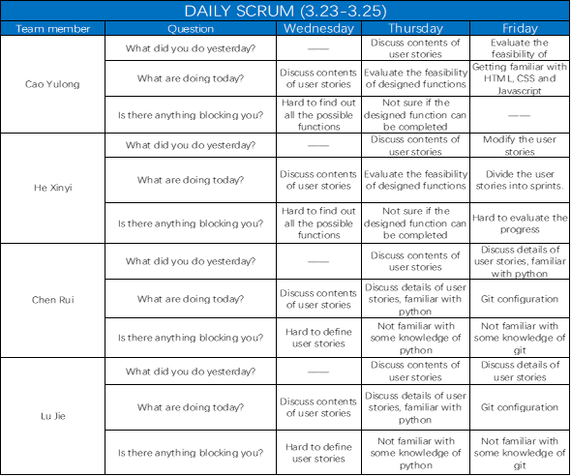
Daily scrum

Slide 28
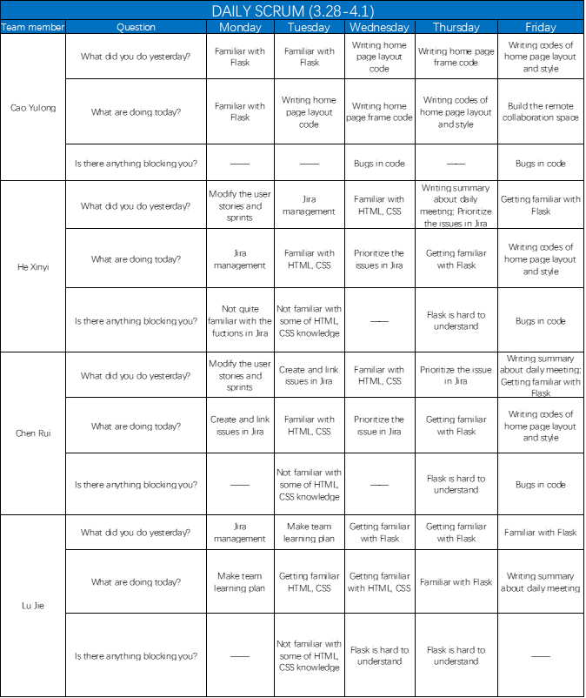
Daily scrum

Slide 29
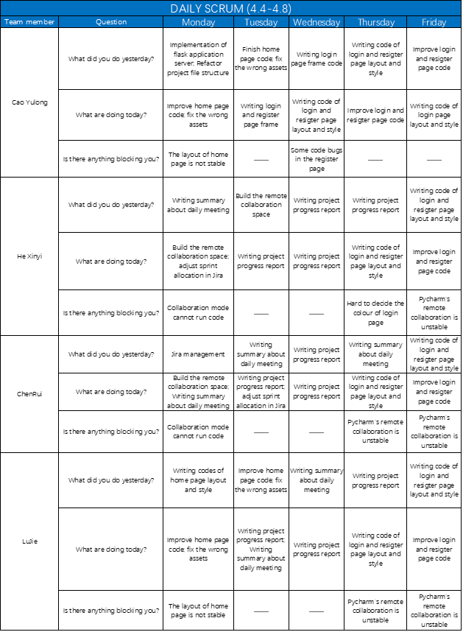
Daily scrum

Slide 30
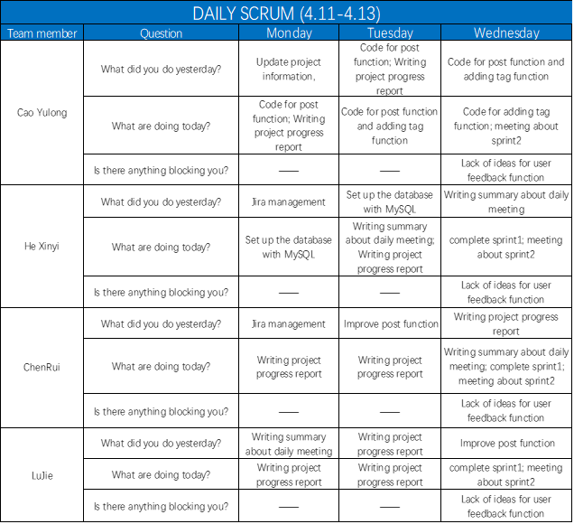
Daily scrum

Slide 31
References
Jira productors. (2018, January 9). Jira Documentation, from Jira Documentation: https://confluence.atlassian.com/jira
Erica Chappell. (2020, February 21). What’s A Burn Up Chart & How Do You Use It, from What’s A Burn Up Chart & How Do You Use It: https://clickup.com/blog/burn-up-chart/
Team Asana. (2021, October 11). Burndown chart: What it is and how to use it, from Burndown chart: What it is and how to use it: https://asana.com/resources/burndown-chart
David Lowe. (2017, May 15). Sprint Reports, from Sprint Reports: https://scrumandkanban.co.uk/sprint-reports/
David Lowe. (2022, Feburary 4). Velocity report, from Velocity report: https://docs.microsoft.com/en-us/previous-versions/azure/devops/report/sqlreports/velocity?view=tfs-2017
Caitlin Mackie. (2020, December 15). What is the difference between sprints and versions in Jira, from What is the difference between sprints and versions in Jira: https://www.easyagile.com/blog/sprints-versions-jira/
Luke Harrison. (2021, December 21). How to Create a Forum Website, from How to Create a Forum Website: https://websitesetup.org/create-a-forum-website

Slide 32
Thanks for listening!

